Slide 1
TOPIC A1:
COMPUTER FUNDAMENTALS
LESSON A1-2
THE FETCH, DECODE, EXECUTE CYCLE
Notes:
0:00-0:01. Checker Dance from Deltarune playing on entry. Guided Notes handed out at the door. Tell them to open their CPU diagram from last lesson before they sit down - today is built directly on top of it.

Slide 2

AGENDA
Primary memory: registers, cache, RAM, ROM
Cache hits and cache misses
The fetch, decode, execute cycle
LMC: running a real program on a real machine
Pipelining and multi-core [HL]
PA A1-1: Cache Memory
WHAT U NEED 4 LESSON
PyCharm
Guided Notes
Your A1-1 CPU diagram
A browser
Notes:
0:01-0:02. Point out the shape of the day: forty minutes on how memory and the cycle work, then a proper programming block. Warn them the second half is Python so nobody is surprised when PyCharm has to open.

Slide 3
THE WARM UP QUESTION
From the CPU diagram we built last lesson:
(a) Which register holds the address of the next instruction to be fetched?
(b) Which register holds the instruction currently being executed?
(c) Which bus carries an address from the CPU to memory - and is it one-way or two-way?
-> Notes Q1 (a)-(c) [3 marks] - do them now
Notes:
0:02-0:03. Silent, two minutes. Do not let anyone shout the answer.

Slide 4
THE WARM UP ANSWER
(a) Program Counter (PC)
(b) Instruction Register (IR)
(c) The address bus - unidirectional, CPU to memory only
All of these will come back today
Notes:
0:03-0:04. Someone will have said the PC holds the instruction. Correct it out loud - it is the single most common slip on this topic and it will cost them a mark in September.

Slide 5
PRIMARY MEMORY
Last lesson we drew registers inside the CPU and 'memory' as one box outside it.
Doing this was a lie of convenience.
There are four kinds of primary memory, and the CPU treats them very differently.
Notes:
0:04-0:05. Framing. They already drew the top of the memory hierarchy last week without being told that is what it was. Keep this to a minute - step 2 is ten minutes now, not twelve.

Slide 6
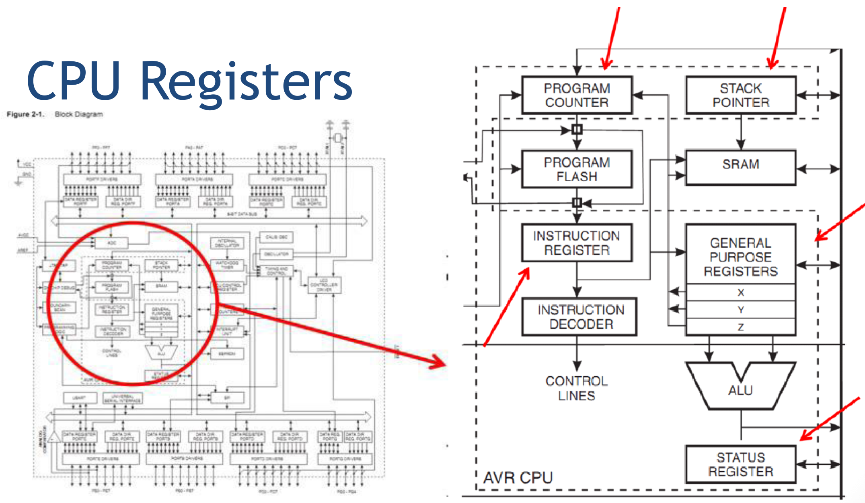
PRIMARY MEMORY
Registers
Storage built directly into the CPU - you have already labelled five of them
Fastest thing in the machine: the ALU reads them in a single clock cycle
Tiny. A handful of values, measured in bytes, not gigabytes
Volatile - contents vanish when power is lost
Notes:
0:05-0:07. Anchor it to their diagram: IR, PC, MAR, MDR, AC are all registers.

Slide 7
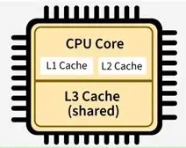
PRIMARY MEMORY
Cache (Level 1, Level 2, Level 3)
Small, fast memory that holds copies of things from RAM the CPU expects to want again
L1: smallest and fastest, one per core, closest to the ALU
L2: bigger, a little slower, usually still per-core
L3: biggest and slowest of the three, normally shared between all cores
Volatile
Notes:
0:07-0:09. The syllabus names L1, L2 and L3 explicitly. The pattern: as cache gets bigger it gets slower. That is not a design failure, it is physics - a bigger array takes longer to search.

Slide 8
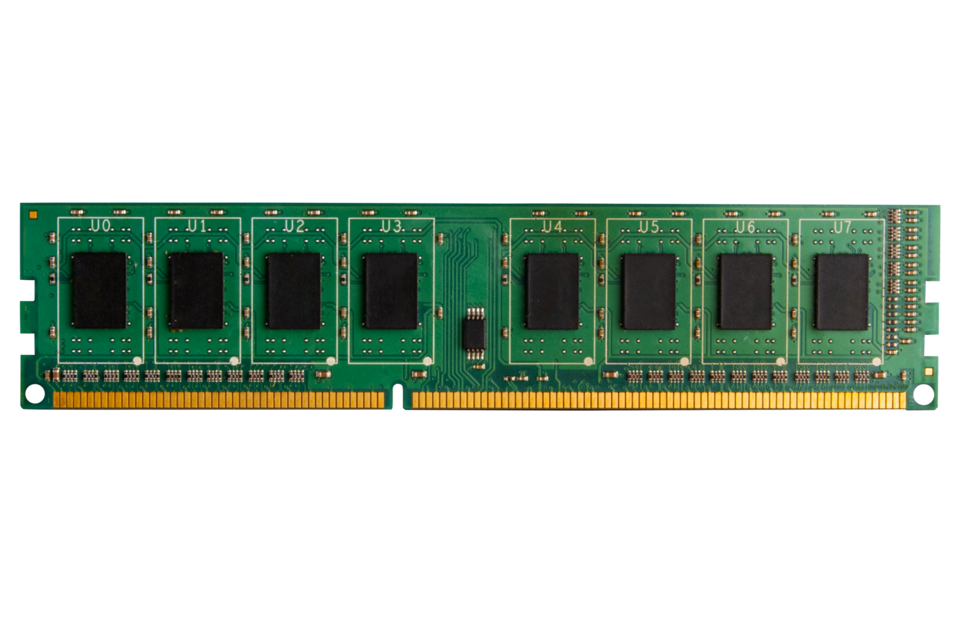
PRIMARY MEMORY
RAM - Random Access Memory
The main working memory: running programs and their data live here
Gigabytes of it, but roughly 100x slower to reach than cache
Volatile - this is why unsaved work dies in a power outage
Notes:
0:09-0:10. Keep this one short. The number that matters is the 100x, because it is the same 100 ns they are about to use in Notes Q4.

Slide 9
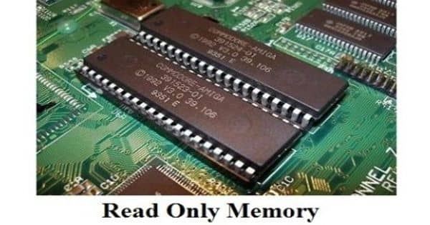
PRIMARY MEMORY
ROM - Read Only Memory
Non-volatile - survives power loss
Holds the firmware that starts the machine before an OS exists (BIOS / UEFI)
Cannot be written to, only read from
Notes:
0:10-0:11. The question they always ask: if the computer needs an OS to run, what runs before the OS is loaded? Answer: code sitting in ROM. That is the whole reason it exists.

Slide 10
PRIMARY MEMORY
Top to bottom: faster, smaller, more expensive per byte
Registers <1 ns bytes
L1 / L2 / L3 1-20 ns KB to MB
RAM ~100 ns GB
ROM slow MB, fixed
-> Notes Q2 [4 marks] and Q3 [2 marks] - do them now
Notes:
0:11-0:14. Draw the pyramid on the whiteboard next to their A1-1 diagram so both are visible at once. Two minutes on Q2 and Q3, then take answers fast and move - the time for this step came out of here.

Slide 11
CACHE HITS AND MISSES
The CPU asks for the contents of a memory address.
CACHE HIT - it is already in cache. Fetch it from there.
CACHE MISS - it is not. Go all the way out to RAM, and copy it into cache on the way back, in the hope that it gets asked for again.
Notes:
0:14-0:15. These two terms are named in the syllabus in exactly these words, which tells you they will be asked for by name.

Slide 12
CACHE HITS AND MISSES
Cache access: 1 ns
RAM access: 100 ns
A miss costs 100x more than a hit. Yikers.
average access time = (hit rate x 1) + (miss rate x 100)
Notes:
0:15-0:17. Write the formula on the board and leave it there - they need it for Notes Q4 and again for Part 3 of the assignment.

Slide 13
CACHE HITS AND MISSES
Run: A1-CacheSimulation.py
What’s the difference in speed between a 50% and 99% cache hit rate in terms of time?
Notes:
0:17-0:18. Ask before you reveal the 99% row: we go from 90 to 99, how much faster? They will guess about ten percent. Let them be wrong first - it is the whole reason chip designers spend a third of the die area on cache.

Slide 14
CACHE HITS AND MISSES
Run: A1-CacheSimulation.py
50% hit rate -> 50.50 ns
90% hit rate -> 10.90 ns
99% hit rate -> 1.99 ns
50% to 99% is 25x faster. Even 90% to 99% - nine points - is 5.5x.
Notes:
0:18-0:19. The answer to the slide 13 question is 25x (50.50 / 1.99). Then push further: going 90 to 99 still buys 5.5x. Nine percentage points. That is why chip designers spend a third of the die area on cache.

Slide 15
CACHE HITS AND MISSES
-> Notes Q4 (a)-(d) [5 marks] - do them now
(a) Define cache hit
(b) Define cache miss
(c) 90% hit rate, cache 1 ns, RAM 100 ns. Calculate the average access time. Show working.
(d) The hit rate drops to 50%. Calculate the new average access time.
Notes:
0:19-0:21. Answers: (c) 0.9 x 1 + 0.1 x 100 = 10.9 ns. (d) 0.5 x 1 + 0.5 x 100 = 50.5 ns. Insist on the working line for (c) - it is worth 2 and the answer alone gets 1.

Slide 16
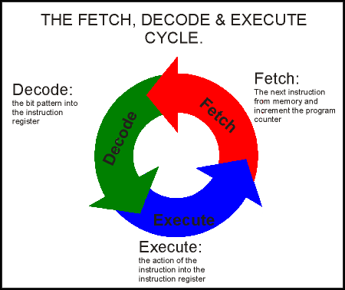
THE FETCH, DECODE, EXECUTE CYCLE
Everything computers do is this loop, run a few billion times a second:
FETCH
get the next instruction out of memory
DECODE
work out what it is asking for
EXECUTE
do it
Open your A1-1 diagram, or the slides from last time to get access to it
Notes:
0:21-0:22. Get the diagram on every screen before you go further.

Slide 17
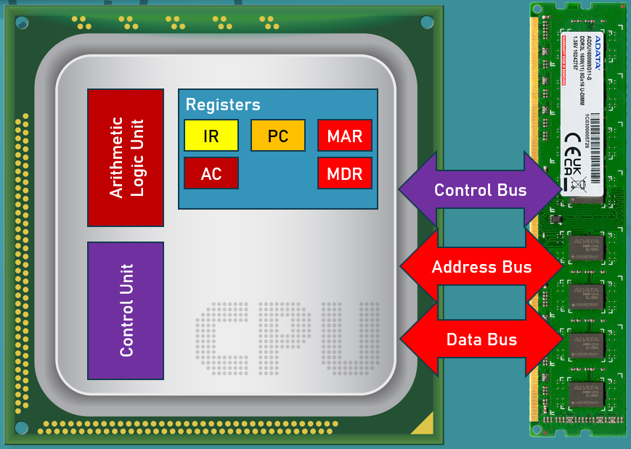
THE FETCH, DECODE, EXECUTE CYCLE
FETCH
1. The address of the next instruction is copied from the PC into the MAR
2. The MAR puts that address onto the ADDRESS bus
Nothing has left the CPU until step 2. Step 1 is internal.
Notes:
0:22-0:23. Point at PC then MAR on the diagram as you say it, then trace the address bus out to the memory box.

Slide 18
THE FETCH, DECODE, EXECUTE CYCLE
FETCH
3. The control unit sends a READ signal along the CONTROL bus
4. The instruction travels back along the DATA bus and lands in the MDR
Three buses, three different jobs. Address says where, control says what to do, data carries the info
Notes:
0:23-0:25. This is the sentence to make them write down - it is the answer to Notes Q10.

Slide 19
THE FETCH, DECODE, EXECUTE CYCLE
FETCH
5. The instruction is copied from the MDR into the IR
6. The PC is incremented so it points at the next instruction
The PC increments during FETCH - not after EXECUTE.
By the time the CPU starts working, it already knows where it is going next.
Notes:
0:25-0:26. Say the warning twice. This is the classic exam trap and it turns up on Notes Q6 in about ninety seconds.

Slide 20
THE FETCH, DECODE, EXECUTE CYCLE
DECODE
7. The control unit reads the opcode (operation code) sitting in the IR and works out what is needed
EXECUTE
8. The ALU performs the operation; the result is placed in the accumulator (AC)
Then back to step 1 perpetually
Notes:
0:26-0:27. Note that not every instruction uses the ALU - STORE just writes memory - but the syllabus wants the ALU/AC pairing.

Slide 21
THE FETCH, DECODE, EXECUTE CYCLE
Run: A1-FetchDecodeExecuteTrace.py
The same cycle, one stage at a time, on the machine you drew last lesson.
It waits for input between every stage.
Before each one: which register changes next, and which bus is doing the work?
Notes:
0:27-0:32. This is the visual for the whole of step 4 - do not just run it, drive it. Press Enter only after somebody has committed to an answer. Cycle 1 in full, slowly; that is where the six fetch stages land. Then speed up. Watch for the FETCH 4 panel: memory still holds the value after it has been read, which kills the 'reading empties memory' idea before it forms. Press 'a' to let cycles 2-4 run themselves if you are short of time.

Slide 22
THE FETCH, DECODE, EXECUTE CYCLE
-> Notes Q5 [5 marks] - fill in the ten blanks now, while it is on the board
If you have been filling these in as we went, you are already finished.
Notes:
0:32-0:33. Q5 answers in order: PC, MAR / address / read / data, MDR / IR / incremented / control unit / ALU, accumulator. Take these verbally while they are still on the demo panel, then move straight into LMC.

Slide 23
LMC: A REAL MACHINE
A1-FetchDecodeExecute.py was a simulation of a CPU, let’s try it on a more complete model
Little Man Computer – an assembler and machine, in your web browser:
peterhigginson.co.uk/lmc
You are about to write machine code (assembly) and watch it execute.
Notes:
0:33-0:35. Get the site open on every machine before you say anything else - that is the step most likely to eat time. If the site is blocked, fall back: they run A1-2-fde-trace.py themselves in pairs and step it. Say the sentence about it being real - after twenty minutes of diagrams, the fact that this thing actually assembles matters to them.

Slide 24
LMC: TYPE THIS IN
Type this into the assembly box on the right. Exactly as written.
LDA NUM1
ADD NUM2
STA RESULT
HLT
NUM1 DAT 12
NUM2 DAT 30
RESULT DAT 0
Click the ‘Assemble into RAM’ button to ‘compile’ the code
Notes:
0:35-0:39. Four minutes. Circulate hard, this is where the typos live. LDA not LOAD, STA not STORE, HLT not HALT. DAT reserves a mailbox and puts a value in it. Point out what happened in the mailboxes: the assembler placed NUM1, NUM2 and RESULT at addresses 4, 5 and 6, right after the four instructions - nobody told it to, it just fills downwards. LDA NUM1 has become 504: a 5 for LDA, then 04 for the address.

Slide 25
LMC: STEP IT
Drag SPEED to its slowest setting first. Then press STEP, not RUN.
Watch the PC and the ACC. Watch RAM spot 6.
Read what the simulator says during FETCH:
“...In parallel add 1 to the Program Counter.”
-> Notes Q6 [4 marks] - fill in the trace table as you step
Notes:
0:39-0:42. Slowest speed or the narration does not appear. Let them find the PC line themselves rather than reading it out - it lands harder. Q6 answers: cycle 1 PC 1, IR LDA 4, AC 12, no change. Cycle 2 PC 2, IR ADD 5, AC 42, no change. Cycle 3 PC 3, IR STA 6, AC 42, yes - address 6 becomes 42. Cycle 4 PC 4, IR HLT, AC 42, no change.

Slide 26
WHAT LMC HIDES
LMC shows PC, ACC, IR and AR.
Its IR holds only the opcode digit - the 5 in 504.
Its AR holds the address digits - the 04. That is our MAR, under another name.
There is no MDR anywhere. There are no buses anywhere.
Every simulator is a simplification. Worth knowing what the LMC excludes
Finished early? Add OUT before HLT, then swap ADD for SUB and predict the answer.
Notes:
0:42-0:43. Short but do not skip it - a sharp student will already have asked what AR is. This is also the honest answer to why we ran the Python demo first: it showed MAR, MDR and the three buses precisely because LMC cannot. Q8 and Q10 on the notes are about exactly the parts LMC hides. SUB extension answer: 12 - 30 = -18, and LMC will show it as a negative.

Slide 27
HL ONLY
PIPELINING
So far one instruction has had the whole CPU to itself.
Real processors do not wait. Break the work into four stages:
FETCH -> DECODE -> EXECUTE -> WRITE-BACK
While instruction 1 is being decoded, instruction 2 is already being fetched. This is called pipelining
Notes:
0:43-0:45. HL bullet A1.1.6, but keep the SL students in the room - it costs five minutes and makes the scheduling material in A1-8 land much better. Analogy that works: a laundromat. You do not wait for load one to dry before washing load two.

Slide 28
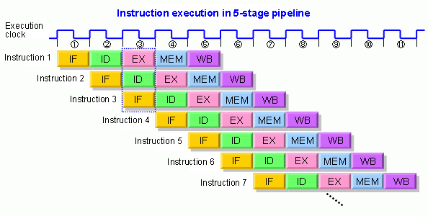
HL ONLY
PIPELINING
Notes:
0:43-0:45. HL bullet A1.1.6, but keep the SL students in the room - it costs five minutes and makes the scheduling material in A1-8 land much better. Analogy that works: a laundromat. You do not wait for load one to dry before washing load two.

Slide 29
HL ONLY
PIPELINING
With the same clock speed, more instructions can be finished per second
In a multi-core processor each core runs its own pipeline, independently and in parallel.
This is why 'more cores' and 'higher clock speed' are two different ways to go faster -
and why old single-threaded software gets nothing from the first one.
-> Notes Q7 (a) and (b) [3 marks] - do them now
Notes:
0:45-0:48. Callback to A1-1: we said then that software has to be written to take advantage of multiple cores. This is the mechanism behind that sentence. Q7 answers: (a) fetch, decode, execute, write-back. (b) stages work on different instructions at the same time, so one instruction completes per clock once the pipeline is full instead of one every four.

Slide 30
EXAM-STYLE QUESTIONS
-> Notes Q8, Q9 and Q10 [8 marks] - silent, four minutes
Q8. Describe the role of the MDR during the fetch stage. [2]
Q9. Explain why a cache miss slows the CPU down, with reference to the memory hierarchy. [3]
Q10. Explain how the three buses interact during the fetch stage of the cycle. [3]
Notes:
0:48-0:52. Genuinely silent. Watch the clock - four minutes, then stop them wherever they are.

Slide 31
EXAM-STYLE QUESTIONS
Mark your own, then total the sheet out of 34.
Q8. Holds the instruction just fetched - the staging point between data bus and IR
Q9. Not in cache, so the CPU goes out to RAM, ~100x slower, and stalls while it waits
Q10. MAR -> address bus; CU sends READ on the control bus; instruction returns
on the data bus into the MDR
Notes:
0:52-0:54. Make them total the sheet and hand it in at the door - the mark out of 34 is the record that the notes were actually done in class.

Slide 32
PA A1-1: CACHE MEMORY
Time for actual Python. Long time no see!
You are going to build the cache we have been talking about, run a real sequence of memory accesses through it, and produce the hit rate and the average access time yourself.
You’ll have the rest of class to work on this programming assignment
Notes:
0:54-0:55. Hand it out. Set the tone: this is not new syntax, it is B2 material they already own. Say that out loud - the rust is the obstacle, not the difficulty.

Slide 33
PA A1-1: CACHE MEMORY
Download from the Resources tab: access_trace.txt
40 memory addresses, one per line, in the order the CPU asked for them. Three phases:
reads 1-20 - a tight loop over addresses 16, 17, 18, 19
reads 21-32 - alternating between address 0 and address 4
reads 33-40 - a single walk through addresses 32 to 39
Notes:
0:55-0:56. Open the file on the projector so they can see it is just integers with a trailing newline. Mention the trailing newline explicitly - int('') is the crash they will all hit.

Slide 34
PA A1-1: CACHE MEMORY
Your cache: 4 addresses (list spaces).
Direct-mapped, so an address may only live in line address % 4.
Part 1 [4] load_trace() - read the file, return a list of ints
Part 2 [8] direct_mapped() - count the hits and the misses
Part 3 [6] average_access_time() - and print a readable report
Part 4 [2] fully_associative_lru() - extension
Reflection questions R1-R4 [10]
Notes:
0:56-0:58. Point out load_trace is straight out of B2.5.1 / Lesson B2-14, and that they should reopen those notes rather than guess. Tell them the target numbers now: direct-mapped gives 16 hits, 24 misses, 40.0%, 60.40 ns. If they get those, Parts 1-3 are right.

Slide 35
PA A1-1: CACHE MEMORY
Work time. 20 minutes.
Try to get through parts 1 and 2 at least today.
Finished early? Go to the reflection questions.
Whatever is left goes home. Due at the start of Lesson A1-3.
Notes:
0:58-1:18. Circulate. Common failures, in the order you will meet them: forgetting int() on the line; forgetting to write the address into the cache line on a miss (gives 0 hits); comparing the line index instead of the stored address (gives far too many hits).

Slide 36
CLOSE
Your direct-mapped cache hit 40% of the time.
The fully associative version in Part 4 gets 65% on exactly the same trace.
Even with the same size and workload, changing the where an address is allowed to sit.
Next lesson: A1-3 - Secondary Storage, Compression, and SaaS.
Everything we touched today is volatile. Wednesday is about the non-volatile data.
Notes:
1:18-1:20. Name the next lesson explicitly. Remind them PA A1-1 is due at the start of it, and that access_trace.txt has to be in the same folder or nothing runs.

Slide 37

VOCABULARY TO REMEMBER
Registers
Cache (L1, L2, L3)
Cache miss
RAM
Average access time
ROM
Fetch, decode, execute
Volatile / non-volatile
Write-back [HL]
Cache hit
Pipelining [HL]
Memory hierarchy
Notes:
Leave this up while they pack. Everything here is fair game on Quiz A1-1.

